Slide 1
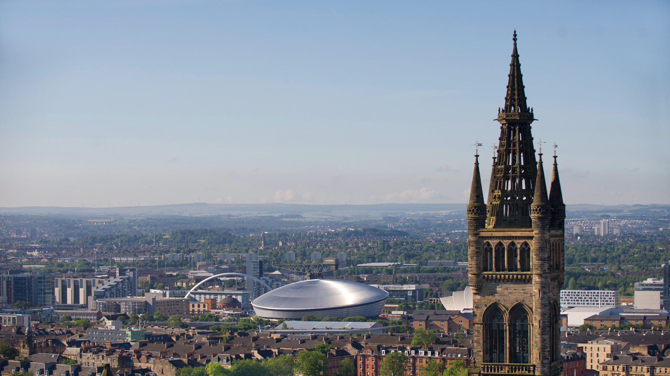



Celtic & Gaelic
Ceiltis & Gàidhlig
Welcome!
Fàilte!
Virtual Open Day
Là Fosgailte Biortail
Notes:
Intro slide - If your presentation does not relate solely to student recruitment, please use this version

Slide 2
Dè na cùrsaichean?
What courses do we offer?
Celtic
Gaelic

Slide 3
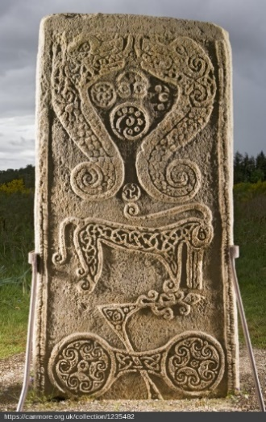
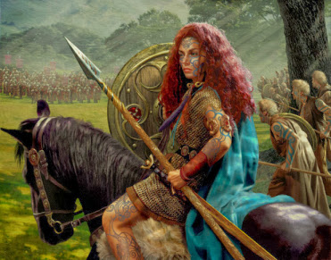
Levels 1 & 2
CELTIC Level 1
2 modules
Celtic Civilisation 1A & 1B
Earliest evidence (BC) of Continental and British ‘Celts’ up to 1100
history archaeology literature art mythology religion gender . . .

Slide 4
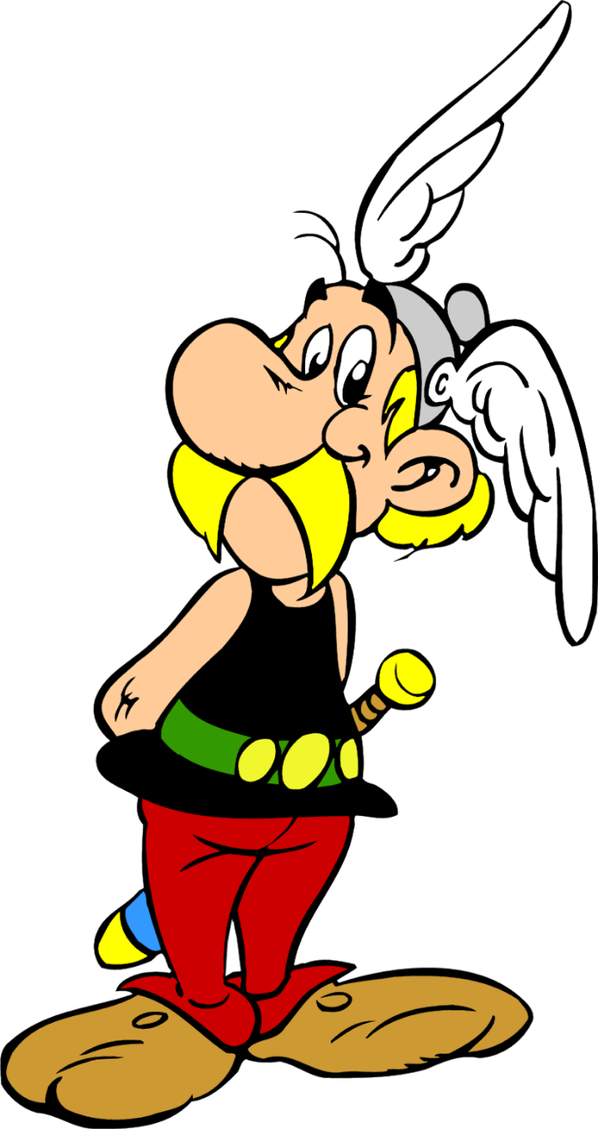
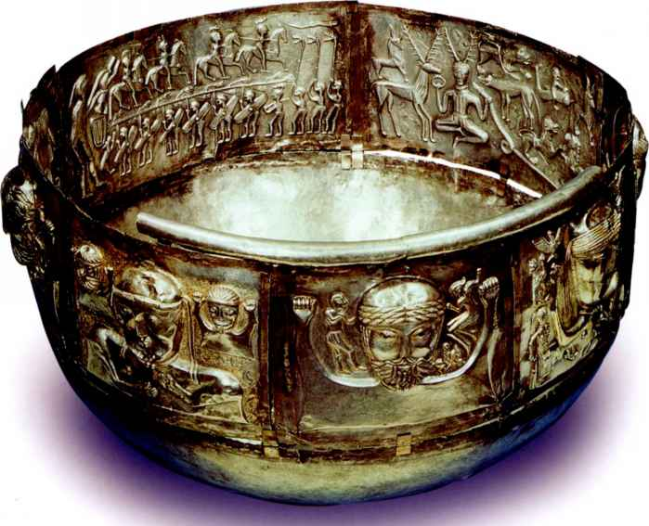
Levels 1 & 2 (1st and 2nd years)
Semester 1 : Celtic Civilisation Level 1A
The Celts in the Ancient World
700BC to AD400
Continental Celts: society, language, religion . .
archaeology, Greek and Roman accounts,
art, coinage, burials, inscriptions

Slide 5
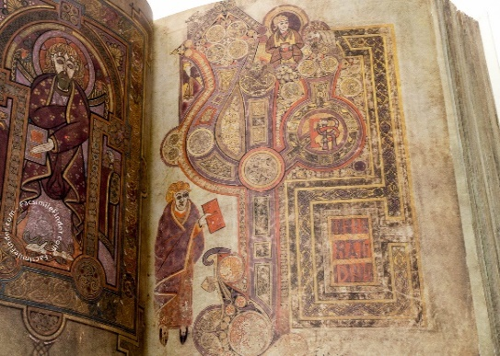
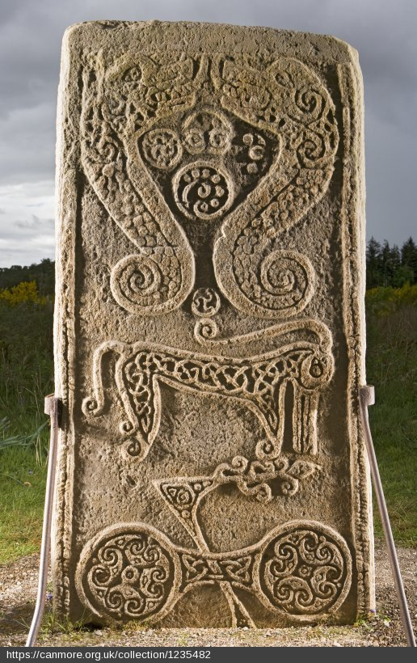
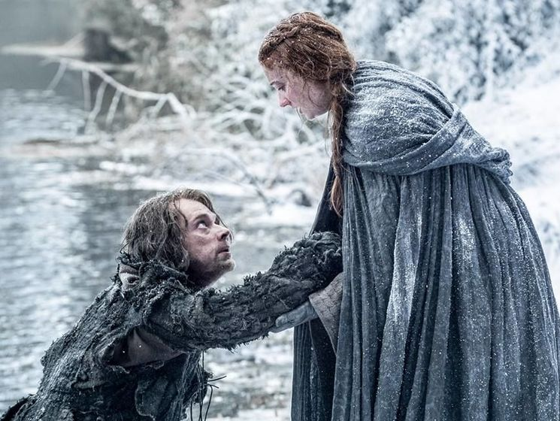
Levels 1 & 2 (1st and 2nd years)
Semester 2 : Celtic Civilisation Module 1B
The Celtic Peoples in the Medieval World
Post-Roman Empire (AD 400 to 1100)
Britain and Ireland
Tribes into kingdoms, Celtic Churches, heroic tales, illuminated Gospel books, Pictish symbols…

Slide 6
Levels 1 & 2 (1st and 2nd years)
Celtic Civilisation Level 1
1A: The Celts in the Ancient World
1B: The Celtic Peoples in the Medieval World
Monday 1pm: lecture
Tuesday 1pm: lecture
Thursday or Friday: small-group tutorial

Slide 7
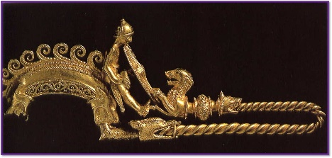
Levels 1 & 2 (1st and 2nd years)
For example: Celtic Civ 1A
Week 2: the Art of the Celts
Lecture 1: Celtic Art and the
emergence of Celtic identity
Lecture 2: Visual culture: Britain & Ireland
Tutorial: Celtic Art (group Show & Tell)
Week 4: Gender
Lecture 1: The War-mad Celt:
image and reality
Lecture 2: Celtic Women: Boudica and her sisters
Tutorial: Discussion of primary texts (Greek & Roman)

Slide 8

Levels 1 & 2 (1st and 2nd years)
Celtic Civilisation Level 1
ASSESSMENT:
Assignment 1: two online worksheets (20%)
Assignment 2: essay (30%)
End of Course exam (50%)

Slide 9
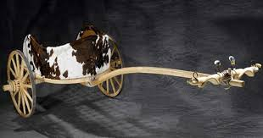
Levels 1 & 2 (1st and 2nd years)
Celtic Civilisation 1A
The Celts in the Ancient World
Assignment 2 (essay) example:
Discuss the role of the chariot in Ancient Celtic Society, outlining the extent to which it is necessary to combine evidence of different types and dates.
OR
Select one of the following areas and discuss the evidence for the presence there of Celtic peoples:
Northern Italy; Iberia; France and Belgium; Ireland;
Central and Eastern Europe; The Balkans; Galatia (Turkey).

Slide 10
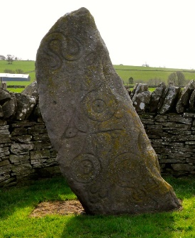
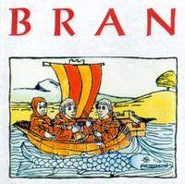
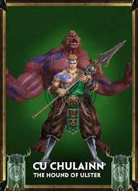
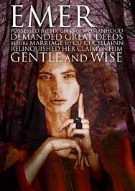
Celtic Civilisation 1B
Celtic Peoples in the medieval period
^{st} and 2nd years)
Assignment 2 (essay) example:
Select ONE art object, and discuss the way in which we may deepen our understanding of the society that produced it through analysing its manufacture, as well as its imagery and ornamentation.
OR
Discuss the nature of the ‘hero’ in
early Gaelic tales.
You may concentrate on either Táin Bó Cuailnge or tales relating to the Otherworld (e.g. The Voyage of Bran).

Slide 11
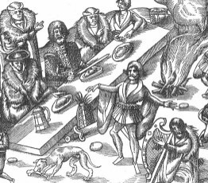
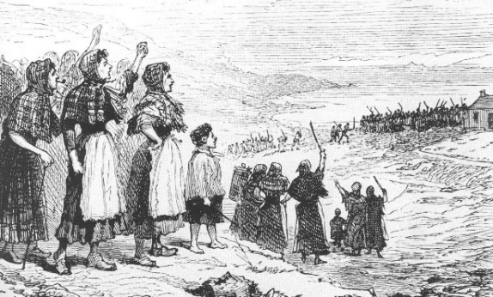
CELTIC Level 2
2 modules
Celtic Civilisation 2A & 2B –
Society & culture of Gaelic Scotland, Ireland & Wales
from 1100 up to the present day

Slide 12
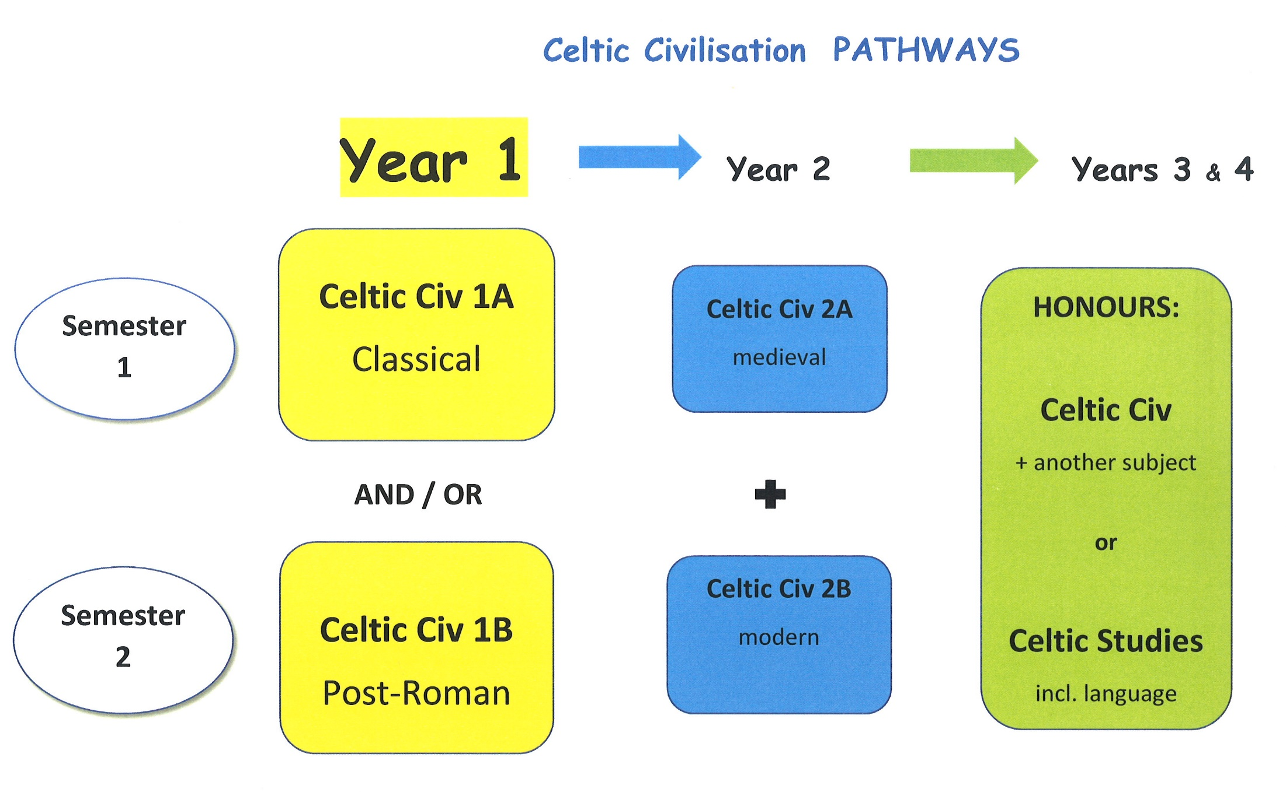
Notes:
Overview of courses
Celtic Civilisation 1 – earliest evidence 1066
Celtic Civilisation 2 – 1066 to present day
Gaelic 1 – language and literature
Gaelic 1A – fluent speakers
Gaelic 1B – beginners
Gaelic 1C – Learners’ Higher
Gaelic 2 – language, literature and linguistics
Gaelic 2A – fluent speakers
Gaelic 2B – students from Gaelic 1B

Slide 13
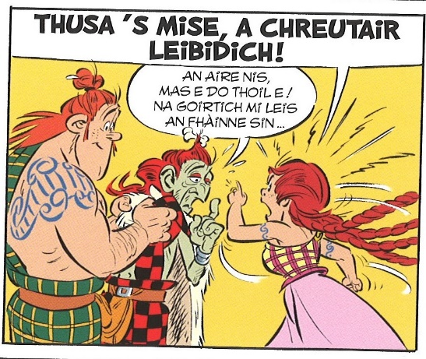
GAELIC Level 1
Gaelic 1 Beginners –
Intensive language course from scratch:
Language skills through conversation,
games, grammar, songs, reading texts
Gaelic 1 Intermediate (Learners Higher)
Gaelic 1 Adhartach (Advanced)– fileantaich
Language skills, fiction, drama, poetry

Slide 14
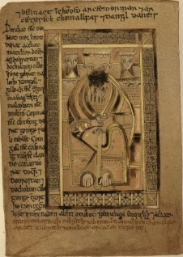
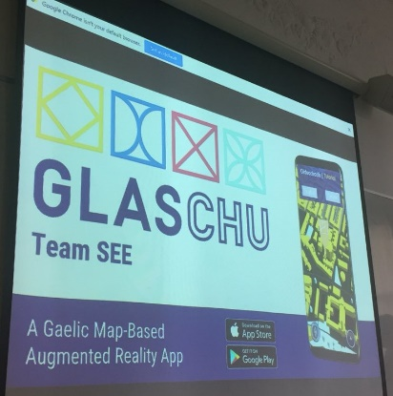
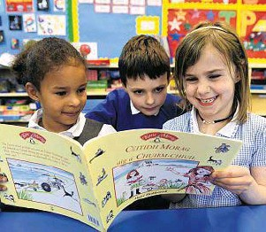
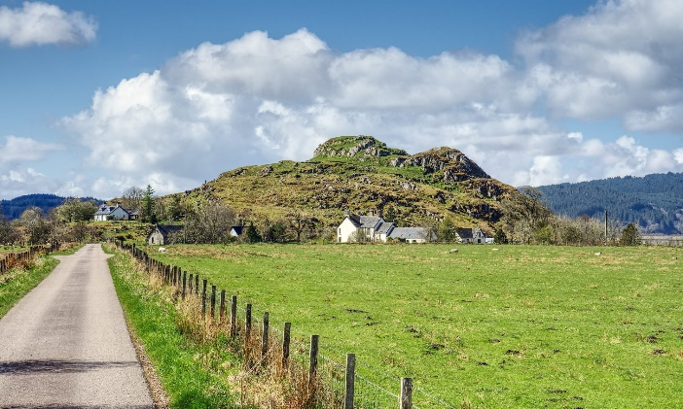
GAELIC Level 1 (all classes)
Core lectures on
Scottish Gaelic society & culture
From earliest times . . .
. . . to the present day

Slide 15
Levels 1 & 2 (1st and 2nd years)
GAELIC 1 Beginners
Classes per week:
Five language classes
(Sem. 2: includes a Reading class)
Online quizzes, oral practice
Assessment:
Weekly language exercises
3 class tests
End-of-year exam
2 oral tests

Slide 16

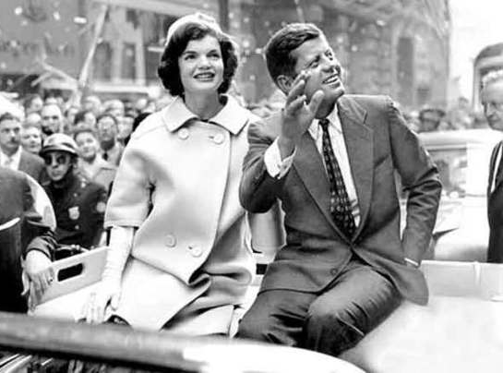
Levels 1 & 2 (1st and 2nd years)
GAELIC 1 Intermediate
Classes per week:
Language skills (2 hrs)
Literature (2 hrs):
Semester 1: fiction / drama
Semester 2: poetry / song

Slide 17
Levels 1 & 2 (1st and 2nd years)
Gaelic 1 Intermediate
Assessment:
Fortnightly language exercises
Gaelic book review (Sem. 1)
Gaelic essay on songs/poetry (Sem. 2)
End-of-course exam
Oral exam

Slide 18

Levels 1 & 2 (1st and 2nd years)
GAELIC Level 1 Advanced
GÀIDHLIG 1 Adhartach
Sgilean Cànain
Litreachas: Ficsean, dràma, bàrdachd

Slide 19
Levels 1 & 2 (1st and 2nd years)
Gàidhlig 1 Adhartach
Measadh:
Obair cànain
1 aiste gach semeastair (dràma & bàrdachd)
Deuchainn
Deuchainn labhairt

Slide 20
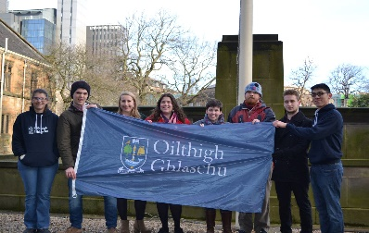
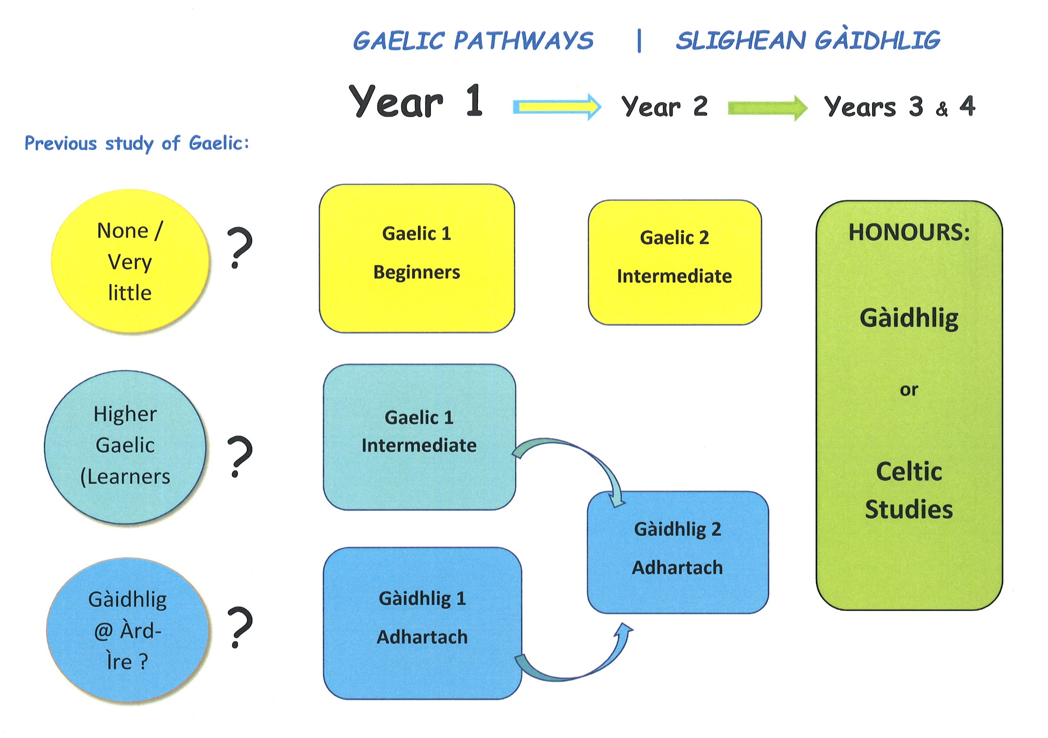
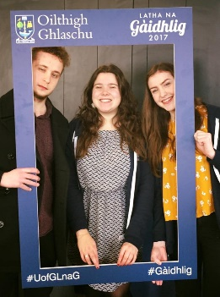
Notes:
Overview of courses
Celtic Civilisation 1 – earliest evidence 1066
Celtic Civilisation 2 – 1066 to present day
Gaelic 1 – language and literature
Gaelic 1A – fluent speakers
Gaelic 1B – beginners
Gaelic 1C – Learners’ Higher
Gaelic 2 – language, literature and linguistics
Gaelic 2A – fluent speakers
Gaelic 2B – students from Gaelic 1B

Slide 21
3rd and 4th year: Honours
Specialist modules in literature, language, history, art, folklore, place-names, music, language planning, etc.
(English and Gaelic)

Slide 22
Our graduates go on to work in:
Also growing demand for GAELIC SKILLS
Media
Teaching Publishing
Journalism
IT
Politics Libraries
Museums
Arts
Language planning

Slide 23


“ Not sure I want to do a whole degree in Celtic or Gaelic …
Can I just do some courses along the way?”
YES !

Slide 24
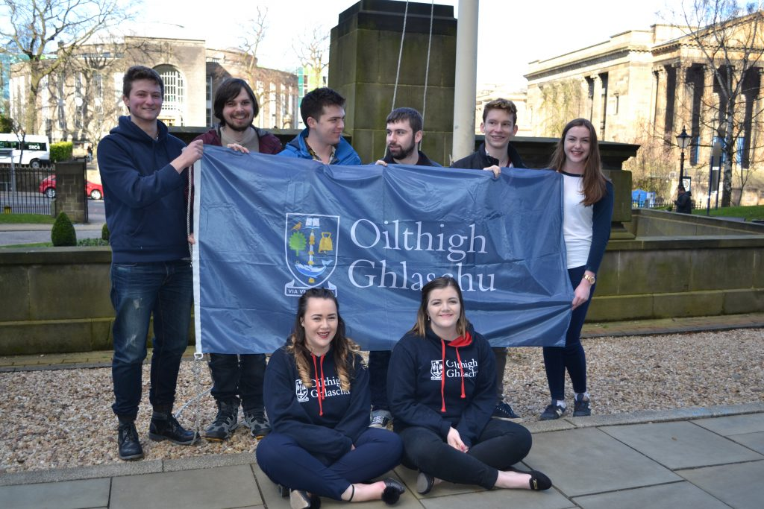
  Why is UofG a great place to study Celtic Studies or Gaelic?

Slide 25
Don’t just take our word for it …
The Complete University Guide for 2020:
‘Best place to study Celtic & Gaelic in Scotland’
National Student Survey, 2019 :
Top in Scotland for student satisfaction (100%).
UK Research Excellence assessment
Ranked 1st Celtic/Gaelic centre in Scotland

Slide 26
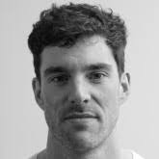
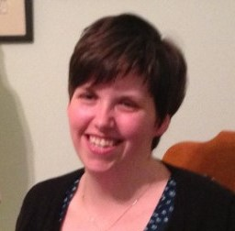
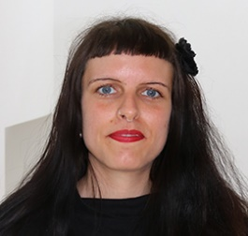
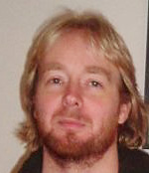
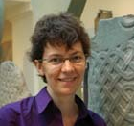
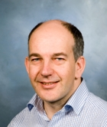
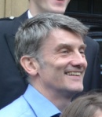

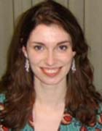
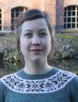
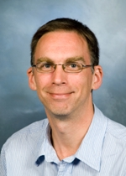
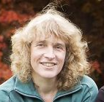
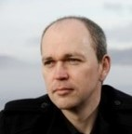
                A friendly, approachable team of specialists who enjoy teaching,
enjoy working in a bilingual environment
and enjoy cooperating with other Subjects:
(e.g. History Archaeology English Language Scottish Literature …)

Slide 27
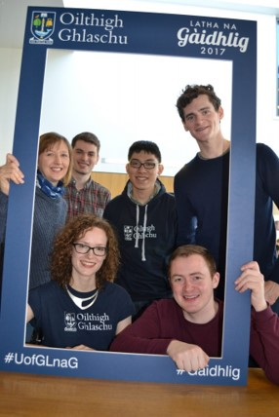
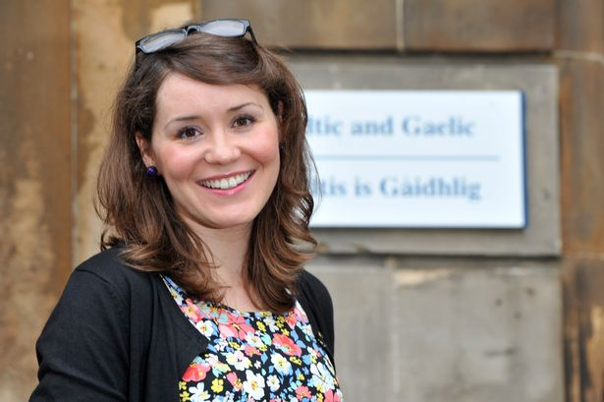
Gàidhlig @ Oilthigh Ghlaschu
a Gaelic presence across campus
  Fiona Dunn, Gaelic Development Manager

Slide 28
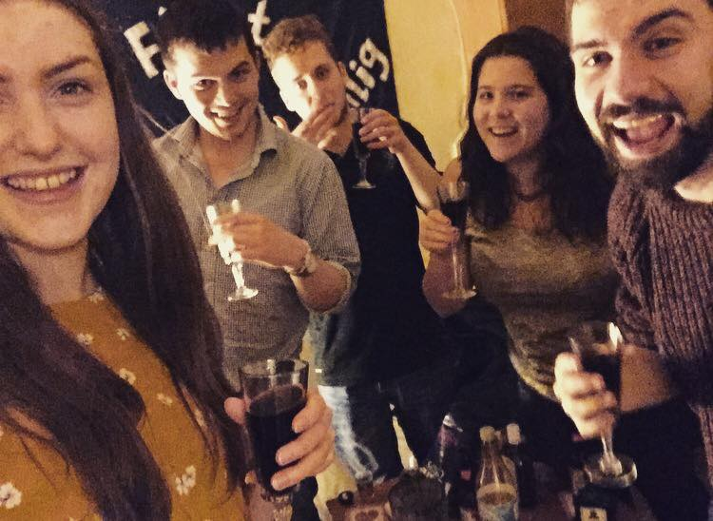



Gàidhlig @ Oilthigh Ghlaschu
craic … ceòl … còmhradh
Gaelic social events and activities
open to all students and staff of UofG
@UofGGàidhlig
OilthighGhlaschu

Slide 29



  Glasgow : Glaschu
Baile mòr nan Gàidheal
Scotland’s most Celtic city:
for centuries home to large Highland and Irish communities
and still the largest urban concentration of Gaelic speakers in Scotland

Slide 30
For more information on
Celtic / Gaelic courses:
Dr Michel BYRNE
michel.byrne@glasgow.ac.uk
CelticGaelic
UniversityOfGlasgowCelticGaelic

Slide 31
For information on
Gaelic activities on campus:
Fiona DUNN
fiona.dunn@glasgow.ac.uk
@UofGGàidhlig
OilthighGhlaschu

Slide 32
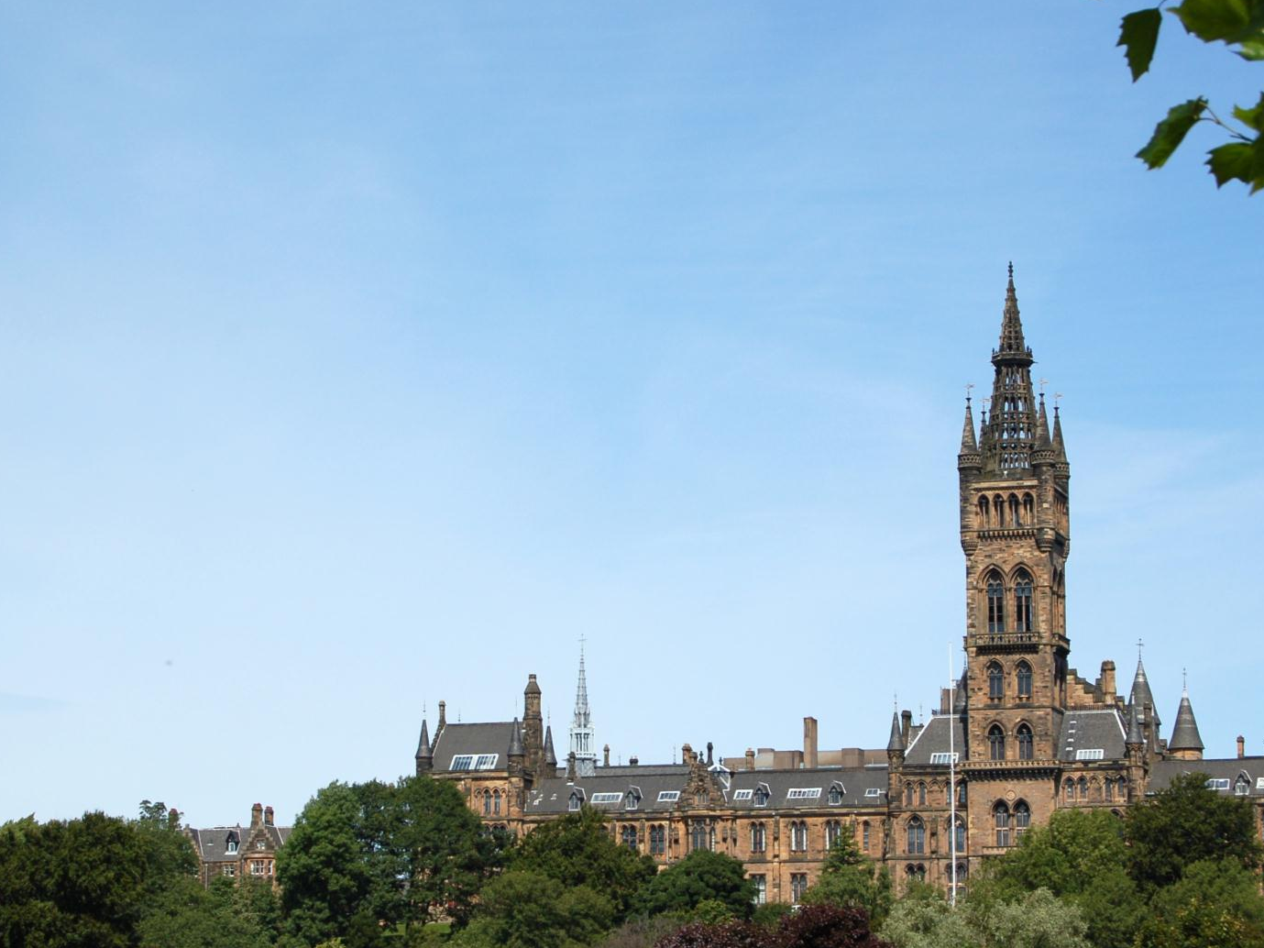


Thanks and stay in touch!
Tapadh leibh!

