Slide 1


Fiscal Aspects of the Scotland Bill: Getting it Right
Stevenson Lecture in Citizenship
Anton Muscatelli, University of Glasgow
Notes:
Pleasure to be here
Because as an academic it’s a rare opportunity to be back in a lecture theatre
Because I helped to organise two cycles of Stevenson lectures – and was involved in editing/contributing to two edited volumes
Caveat – I am speaking as an independent economist not as the Head of this institution.

Slide 2
Key points
Importance of Fiscal Framework alongside the Scotland Bill (2016)
However, it’s important to understand how far economic principles can take us in devolution finance – looking back at Scotland Act (2012) and current Scotland Bill (2016)
Ultimately it is about political choices, but economics can inform those choices, and point out threats and opportunities
The deal reached on 23rd Feb 2016 is a good deal for Scotland the UK
Notes:
Note I cannot focus on all aspects of the fiscal framework. The press and public attention has focused mainly on one aspect in particular and that is the method for determining the block grant to Scotland from Westminster after the devolution of additional taxation and welfare powers. But there are many other aspects of the framework which are very important (eg borrowing powers, the governance of the fiscal framework etc). I will cover as many as I can in the time alotted but cannot obviously go into detail in all these areas.

Slide 3
Calman Commission and Scotland Act (2012)
Commission and Independent Expert Group(s). IEG on Finance started meeting in 2008.
IEG provided a number of scenarios – in the end the Commission, which had political representation from 3 parties made recommendations which were translated into the 2012 Act.
Main additional financial powers centred on some scope to vary income tax and some minor taxes. Introduced some capital borrowing powers,

Slide 4
Calman IEG – First report
Main Key Principles Relating to Devolved Funding Systems
There are three means of funding devolved governments (grants; tax assignment; devolved taxation). Most systems of funding devolved governments are mixed, involving more than one means.
Commission needs to have a clear sense of the constitutional order the UK should have, with financing arrangements following from that.
Notes:
This is what happens in other countries (IEG Report, November 2008), i.e. political/constitutional decisions should be in the lead; economic considerations provide the backdrop to these but are not determinant.

Slide 5
Some key principles of devolved finance:
IEG’s three major principles relating to a devolved funding system
  Equity (Fairness): Does the system allow for levels of public spending which provides an equitable distribution of (access to) tax resources and public services across the UK?
  Efficiency: Does the system avoid creating economic distortions by incentivising movements of people and the factors of production which do not generate new economic activity? (tax competition).
  Accountability/Transparency: Does the devolved body have the autonomy to make spending and taxation decisions at the local level, and is it clear to taxpayers what effects any spending decisions made at the devolved level have on their tax bill?

Slide 6
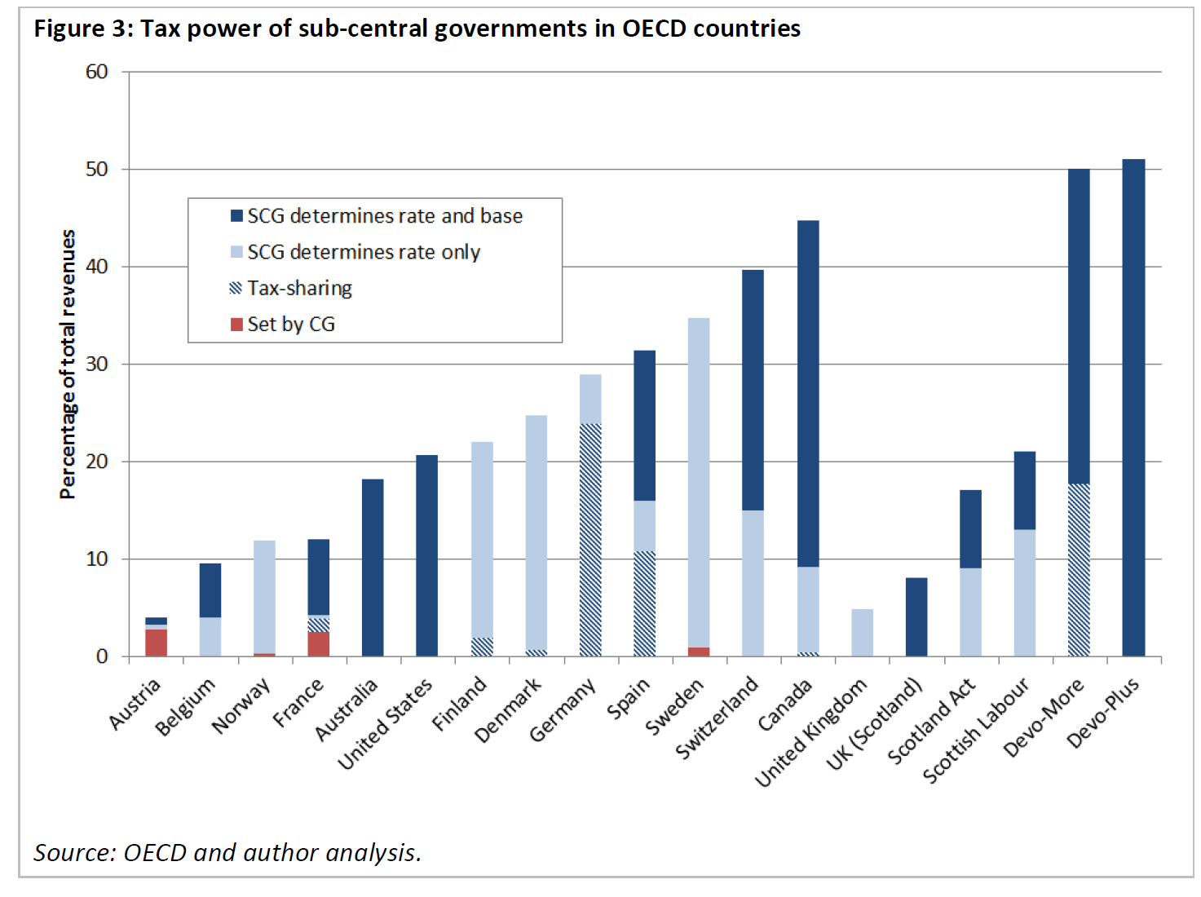
Different political/constitutional systems use different mixes of devolved funding – Bell and Eiser (2014): ‘Scotland’s Fiscal Future in the UK’

Slide 7
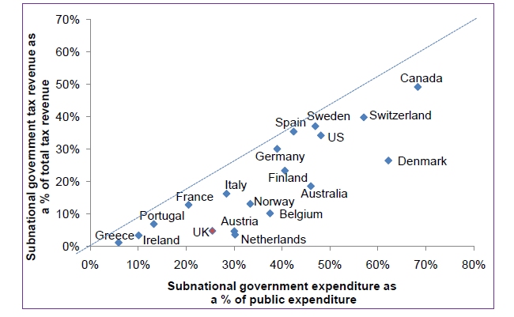
The extent of devolved powers and ‘vertical imbalances’ in 2013 – figure from Report of Holyrood Devolution (further powers) Committee – figure 1

Slide 8
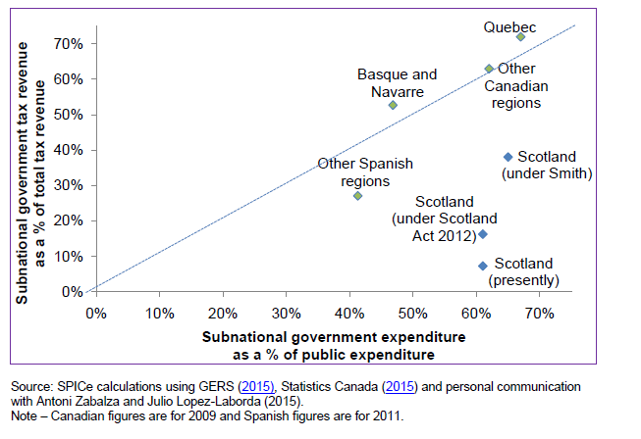
The impact of Scotland Act (2012) and Smith Commission figure from Report of Holyrood Devolution (further powers) Committee – figure 2

Slide 9
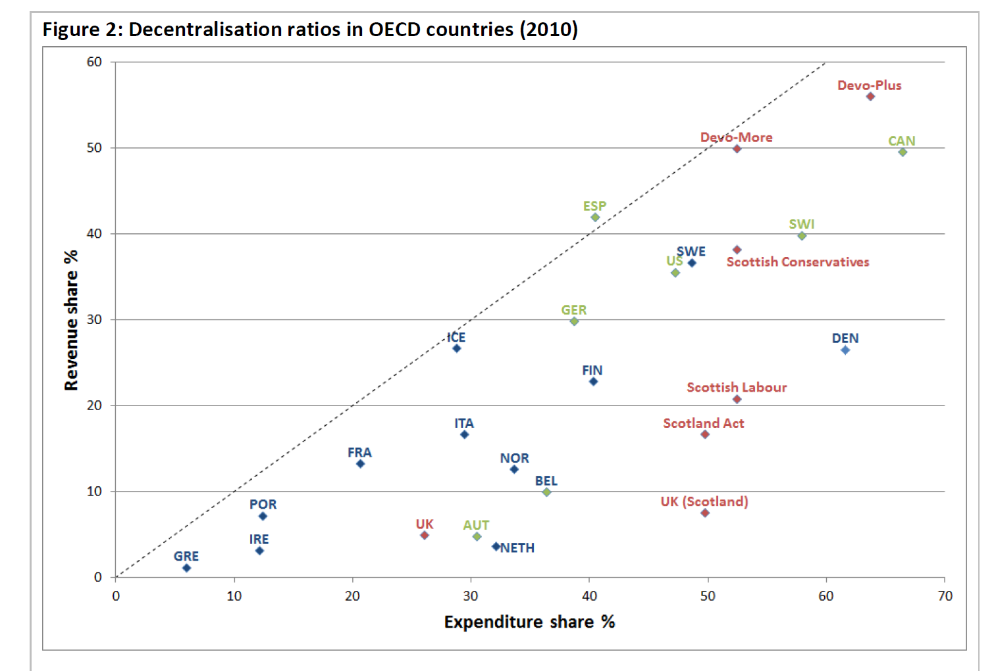
Decentralisation and Vertical Imbalances - Bell and Eiser ‘Scotland’s Fiscal Future in the UK’ Figure 2

Slide 10
Smith Commission Agreement
Fiscal aspects (2013/14 values, £ millions):
 | Scotland Act 2012 | Smith Commission
Non-Domestic Rates/Council Tax | 3,868 | 3,868
Income Tax | 4,258 | 10,911
Stamp Duties | 385 | 385
APD | - | 251
Landfill Tax/Aggregates | 105 | 155
Assigned VAT | - | 5,030
Total Devolved/Assigned Revenues | 8,617 | 20,600
Additional Benefit Spending Devolved | - | 2,521
Devolved Expenditure | 40,813 | 43,334

Slide 11
What’s in a Fiscal Framework?
Block Grant Adjustment
The interpretation of ‘no detriment’ in Smith Commission Agreement
Capital and Revenue Borrowing and Flexibility
VAT assignment
Inter-governmental scrutiny of Fiscal Matters and Governance of Fiscal Framework
Other issues (Tax administration costs; crown estate; employability programme funding)

Slide 12
Smith Commission Agreement (par 95)
The parties agree that the Scottish and UK Governments should incorporate the following aspects into Scotland’s fiscal and funding framework:
The Barnett Formula. The block grant…will continue to be determined via the operation of the Barnett Formula.
Economic Responsibility. The framework…should result in Scotland benefiting fully from policy decisions on expenditure and revenue and bearing the full costs of policy decisions that reduce revenues or increasing expenditure.

Slide 13
Smith Commission Agreement (Contd)
(3) No detriment as a result of the decision to devolve further powers. The Scottish and UK Governments’ budgets should be no larger or smaller simply as a result of the initial transfer of tax and/or spending powers, before considering how these are used. There should be an appropriate indexation of the block grant.
(4) No detriment as a result of UK or Scottish Government Policy Decisions post-devolution.
Where either governments make policy decisions that affect tax or expenditure of the other, there should be compensation based on shared understanding (compensation principle)
Changes to taxes in the rest of the UK for which responsibility to Scotland has been devolved should only affect spending in the rest of the UK. Changes in devolved taxes in Scotland should only affect public spending in Scotland (‘tax-payer fairness’ principle)

Slide 14
Block Grant adjustment
Setting initial baseline should be (relatively!) straightforward
After that, indexation is more complicated.
Three main indexation methods have been suggested
They have different implications and justifications
Ultimately the choice depends on the principles agreed as part of the SCA (can they all be satisfied?) and the main risks facing Scotland’s budget

Slide 15
Block Grant adjustment methods
1. Levels Deduction (see Bell and Eiser, 2014). Block Grant Adjustment (BGA) is updated by adding population share of comparable (devolved) rUK tax revenues
BGA₁=(POP^{S}/POP^{rUK})₀*(T₁^{rUK} – T₀^{rUK})
2. Indexed Deduction (see Holtham, 2010). The BGA is updated by the percentage change in comparable (devolved) rUK tax revenues
BGA₁=(T₁^{rUK}/T₀^{rUK})*BGA₀
3. Per-capita indexed deduction adjusts the index deduction method by relative population growth in Scotland and rUK to allow for the fact that population in the two areas grows at different rates
BGA₁=[(POP^{S}₁/POP^{S}₀)/(POP^{rUK}₁/POP^{rUK}₀)]* (T₁^{rUK}/T₀^{rUK})*BGA₀

Slide 16
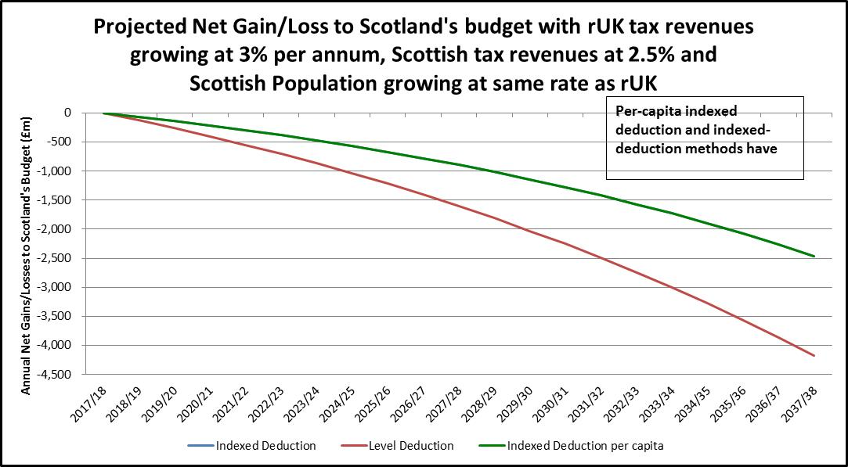
The three methods if rUK and Scottish comparable tax revenues rise at different rates
same impact

Slide 17
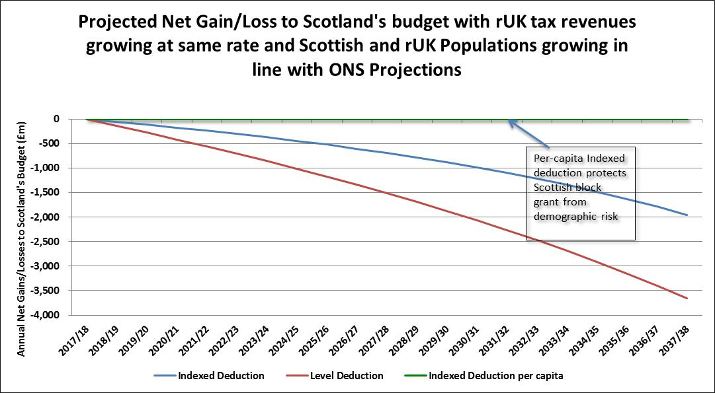
The three methods if rUK and Scottish populations grow at different rates

Slide 18
The three methods if tax revenues in rUK grow faster than Scotland and population follows ONS projections

Slide 19
Which is the best adjustment method?
I’ve suggested, as have STUC and Cuthbert (2015) that the per-capita indexation method is better.
Bell, Eiser and Phillips (2015) suggest that none of the three methods satisfies the two non-detriment principles set out in the SCA:
  1st non detriment principle: ‘no detriment from the decision to devolve’ and
  2nd non detriment principle: ‘no detriment from subsequent policy decisions of the other government’
  LD satisfies the 2nd but not the first, whilst PCID/ID satisfies the 1st but not the second, and PCID additionally protects from demographic shocks.

Slide 20
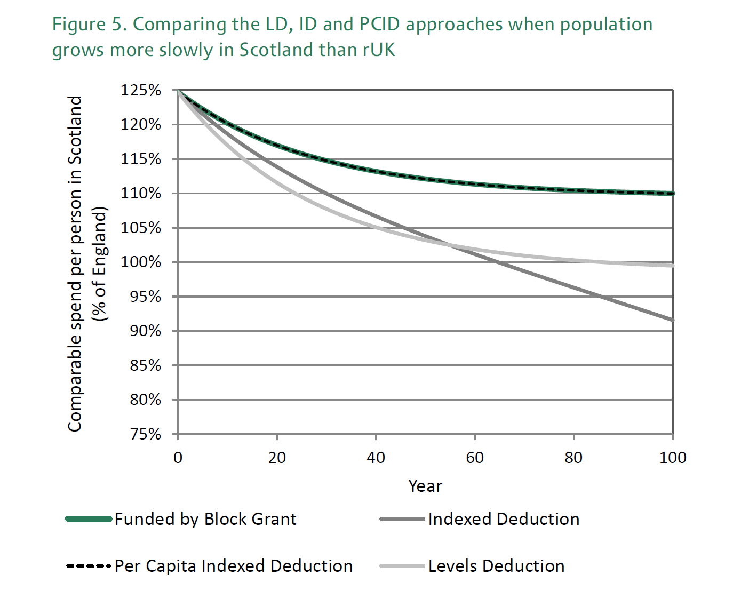
Slower population growth in Scotland – risk and impact of 3 methods – from Bell et al. (2015)

Slide 21
Why is per-capita-indexation better?
Smith Commission Agreement put Barnett formula as a cornerstone. The other methods would in essence work against Barnett, potentially driving spending per head in Scotland inexorably lower. Politically, the first no-detriment principle is likely to be very important.
The 2nd no-detriment principle around ‘tax-payer fairness’ could be satisfied by PCID with an additional adjustment, triggered by changes in rUK (devolved) income taxation (see below).
Although a balanced budget fiscal expansion by UK government might breach the 2nd no-detriment principle under per capita indexed deduction, there is an asymmetry in the relationship between central and devolved government. UK government has a much broader range of economic tools to deal with a deviation from the second principle. Scotland and the other devolved governments do not have the same range of tax powers as the Central government to offset any deviations from that principle.
Scotland arguably does not have all the tools to counteract demographic trends, so it is reasonable to protect devolved governments from additional demographic risk. Scotland is already exposed to demographic risks through Barnett.

Slide 22
Could one improve on PCID to take account of ‘taxpayer fairness’?
One way would be to consider a ‘trigger’ which would operate if rUK increases (devolved) income taxation to fund (devolved) rUK spend on e.g. English NHS, education:
Adjustment=(population share-income tax share) x additional spend in rUK
Remaining issues:
‘organic growth’ due to rUK income tax rise
complexity

Slide 23
The Governance of the Fiscal Framework
The complexity of the BGA issues suggest that transparency, asymmetry of power between the two government in disputes and stability of the framework over time are important.
Transparency – the BGA is difficult to understand and may counteract the additional accountability which the Scotland Bill is due to generate (see the work of the expert group I chaired re the Calman Commission). It is difficult to explain some of the potential impacts to the general public.
Asymmetry of Power Should there be independent oversight of the framework as the Treasury is both a party to the agreement and a referee in the process? Trying to adjudicate on Barnett formula bypass as well as no detriment might be easier if there is an arbitration mechanism. A fiscal arbitration mechanism would not be impossible to design and would not be expensive to set up.
Stability – The framework will need to evolve over time as the structure of taxation and spend and demographics change over time.
Notes:
1. e.g. if the rUK government raises income tax to spend on devolved areas this might advantage Scotland depending on the BGA method. If rUK government raises income tax this automatically disadvantages Scotland through the BGA. So it may be best to keep the system as straightforward as possible.
3. No simple formula will work for ever. Again, a fiscal arbitrator might be able to make recommendations to the two governments for changes in the BGA formula, and review the formula in the future in the light of experience.

Slide 24
Other issues
Block grant adjustment regarding welfare
VAT assignment – How does one accurately identify how much VAT is raised in Scotland? Living Cost and Food survey limited in scope and might not capture positive effects of tourism on Scottish VAT receipts
Borrowing – symmetric and asymmetric shocks in rUK and Scotland and implications for Scotland regarding revenue borrowing. On capital borrowing there is the issue of caps. Also implications for fiscal adjustments/fiscal rules at overall UK level (‘shared effort’ on revenue spend works through Barnett and block-grant adjustment via devolved taxes). Again, a fiscal arbitrator might be helpful here if one wants to create a ‘Federal’ model with symmetric power.
Other issues (Tax administration costs; crown estate; employability programme funding)

Slide 25
Where lies compromise (situation as at 22 February 2016)?
1. PCID with additional adjustment for ‘tax-payer fairness’
2. Levels Deduction with some allowance for tax capacity (see IFS note 23 February)
3. Some ‘floor’ to potential detriment to Scottish block grant
4. Some weighted average of PCID and LD to offset some but not all demographic risk
5. A ‘sunset clause’ after 2021-22 on BGA method adopted in fiscal framework
See letter to Devolution (FP) Committee of 22 February 2016
Notes:
NB This is not economics – except as an example of bargaining!!

Slide 26
Epilogue: The Deal (23 February 2016)
No-detriment (LD-tax capacity methodology? But insuring Scotland for demographic risk – hence same outcome as PCID?) until 2021-22
Independent review for what happens after 2021-22 (but no presumption that methodology will continue – requires approval of both governments, based on experience
Independent scrutiny of economic and tax figures
A Good Deal for Scotland and the UK

