Slide 1
EU Public Perceptions of China and Policy Implications
George Cunningham,
European External Action Service
Glasgow University, 31 October 2012

Slide 2
Discussion points
The EU-China relationship
Historic Chinese migration to Europe
China in Europe’s media
Public opinion polling on China
Sum up and policy implications

Slide 3
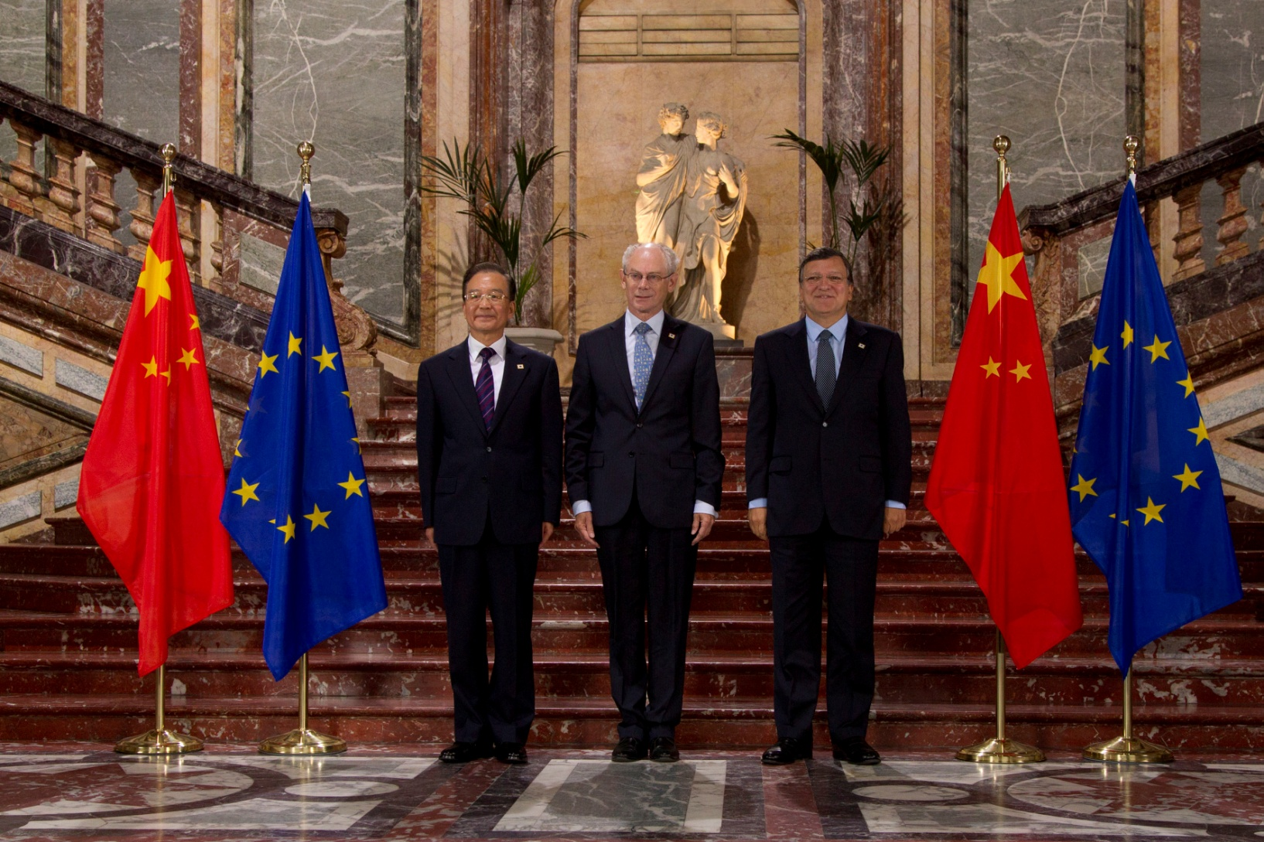
The Evolving EU-China Relationship

Slide 4
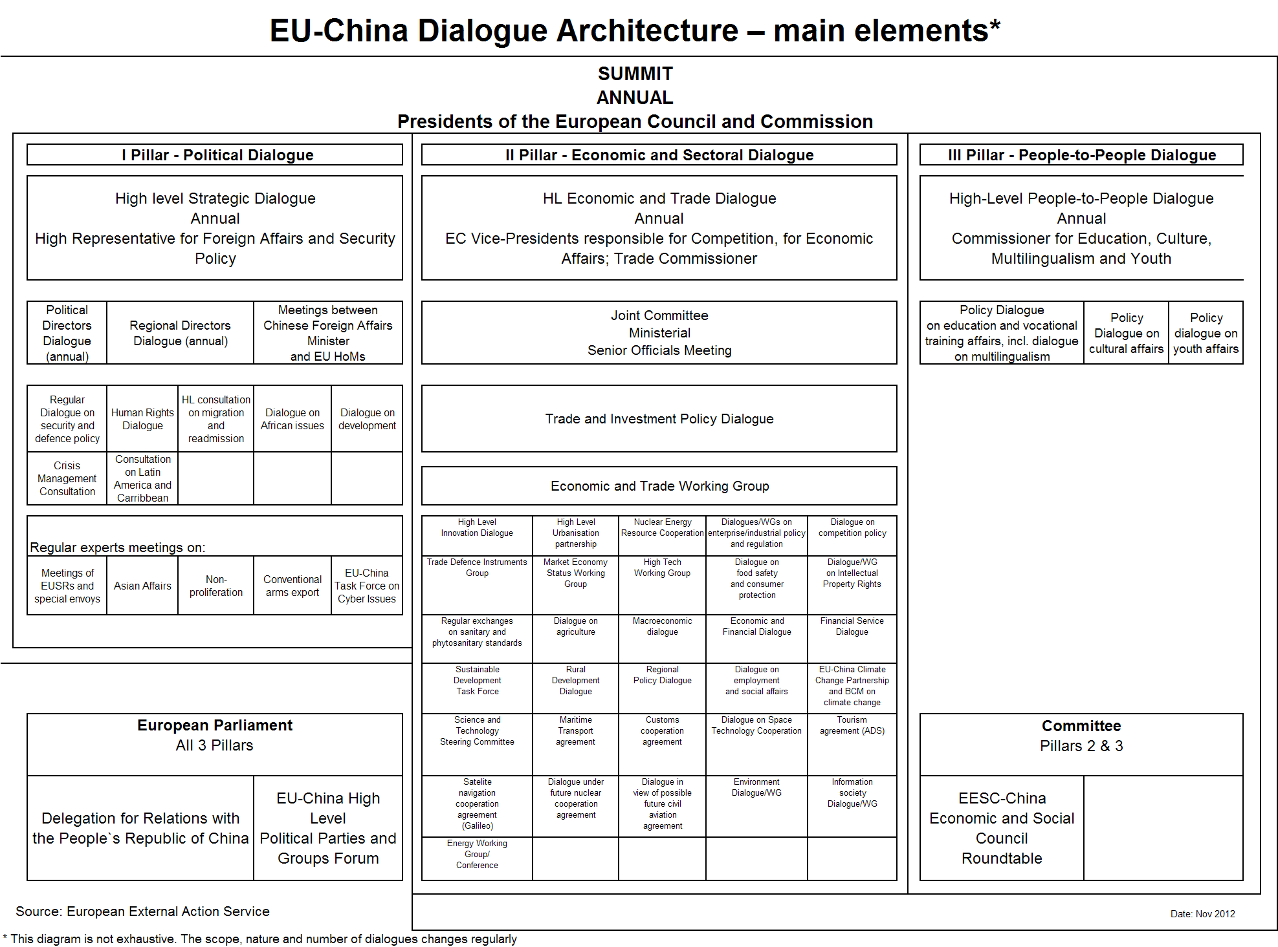

Slide 5
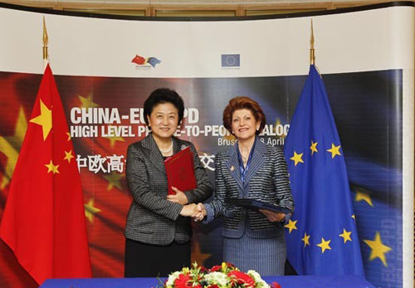
‘People-to-People’ Dialogue

Slide 6

Historic Chinese Migration to Europe

Slide 7
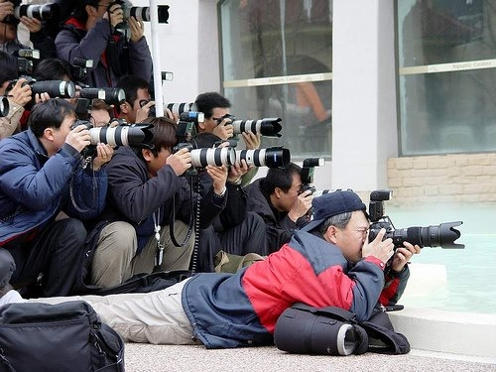
China in Europe’s media

Slide 8
‘Do you have a favourable view of China?’
favourable
UK
Greece
UK
unfavourable
Czech Rep.
Source: Pew Global Attitudes Project, 2012

Slide 9
‘Do you believe that China is fair or unfair in its trade relations with other countries?’ (%)
 | Fair | Neutral | Unfair | ‘Depends'/'Don't Know'
Italy | 29 | 20 | 51 | 0
UK | 23 | 23 | 44 | 10
Spain | 22 | 15 | 51 | 12
Germany | 19 | 19 | 56 | 6
France | 12 | 28 | 59 | 1
Source: Globescan/Pipa, 2010-2011

Slide 10
China becoming more powerful economically
Source: Globescan/Pipa, 2010-2011

Slide 11
USA vs. China: the world’s leading economic superpower
USA China
Source: Pew Global Attitudes Project, 2012

Slide 12
German Opinion: The World’s Leading Economic Superpower
Source: Pew Global Attitudes Project, 2012

Slide 13
China becoming more powerful militarily
Source: Globescan/Pipa, 2010-2011

Slide 14
‘The EU and China have the same interests when dealing with globalisation?’ (%)
Source: Eurobarometer, 2010

Slide 15
‘Will China replace the USA as the world’s largest superpower?’
Source: Pew Global Attitudes Project, 2011

Slide 16
Country Public Perceptions

Slide 17
Policy Implications

Slide 18
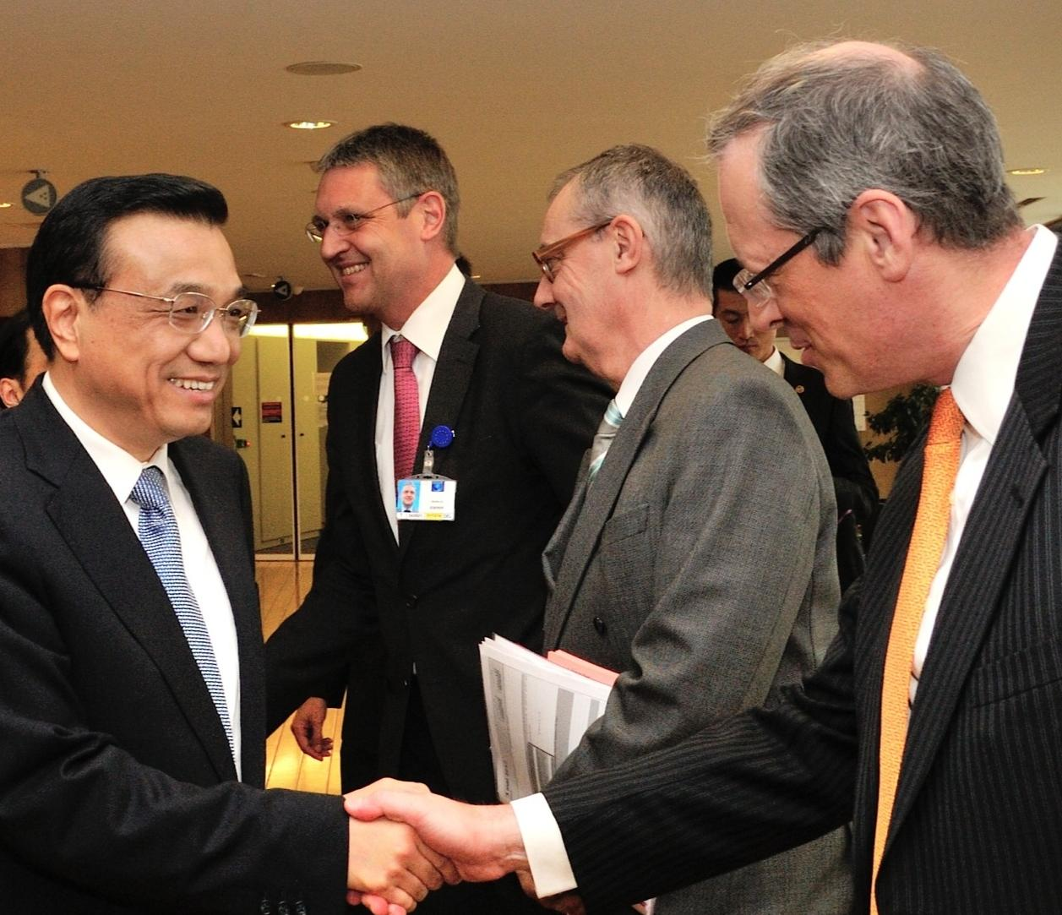
Thank You
Vice-Premier Li Keqiang visits Brussels, May 2012

